Slide 1
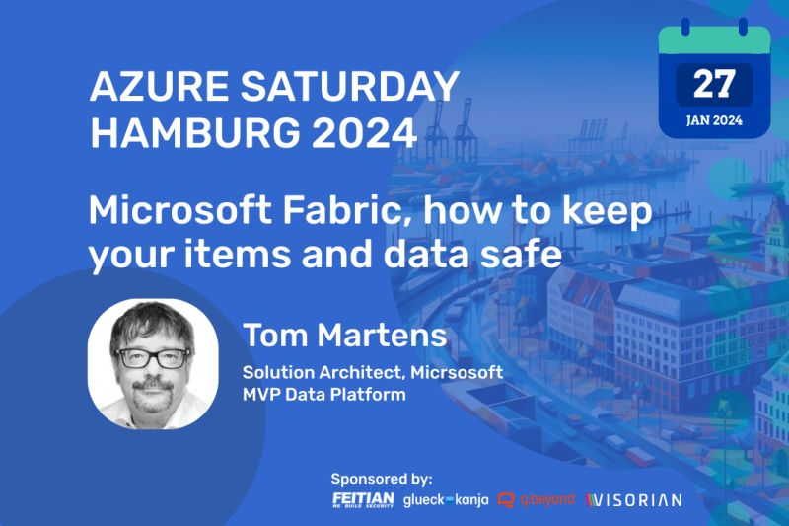
Microsoft Fabric How to keep your items and data safe
Using Microsoft Fabric
Tom Martens @ Azure Saturday Hamburg
2024-01-27

Slide 2




Sponsors

Slide 3
Inside the box
Who I am
Power BI Recap (a quick look behind)
Microsoft Fabric is entering the stage

Slide 4

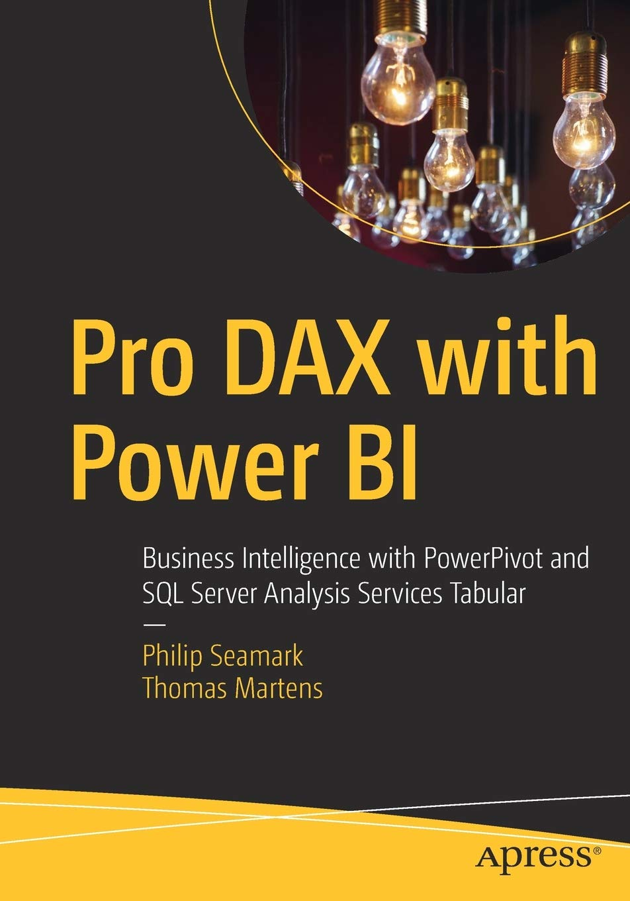
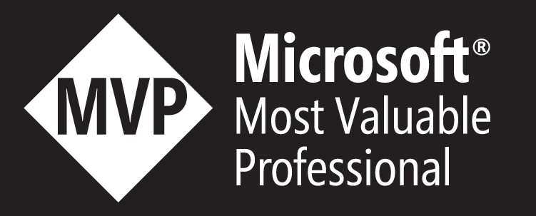
Tom Martens
25+ years of experience designing analytical solutions using the MSFT data platform
Solution Architect @ Munich Re
/tommartens68
@tommartens68

Slide 5

Power BI Recap (a look behind)

Slide 6
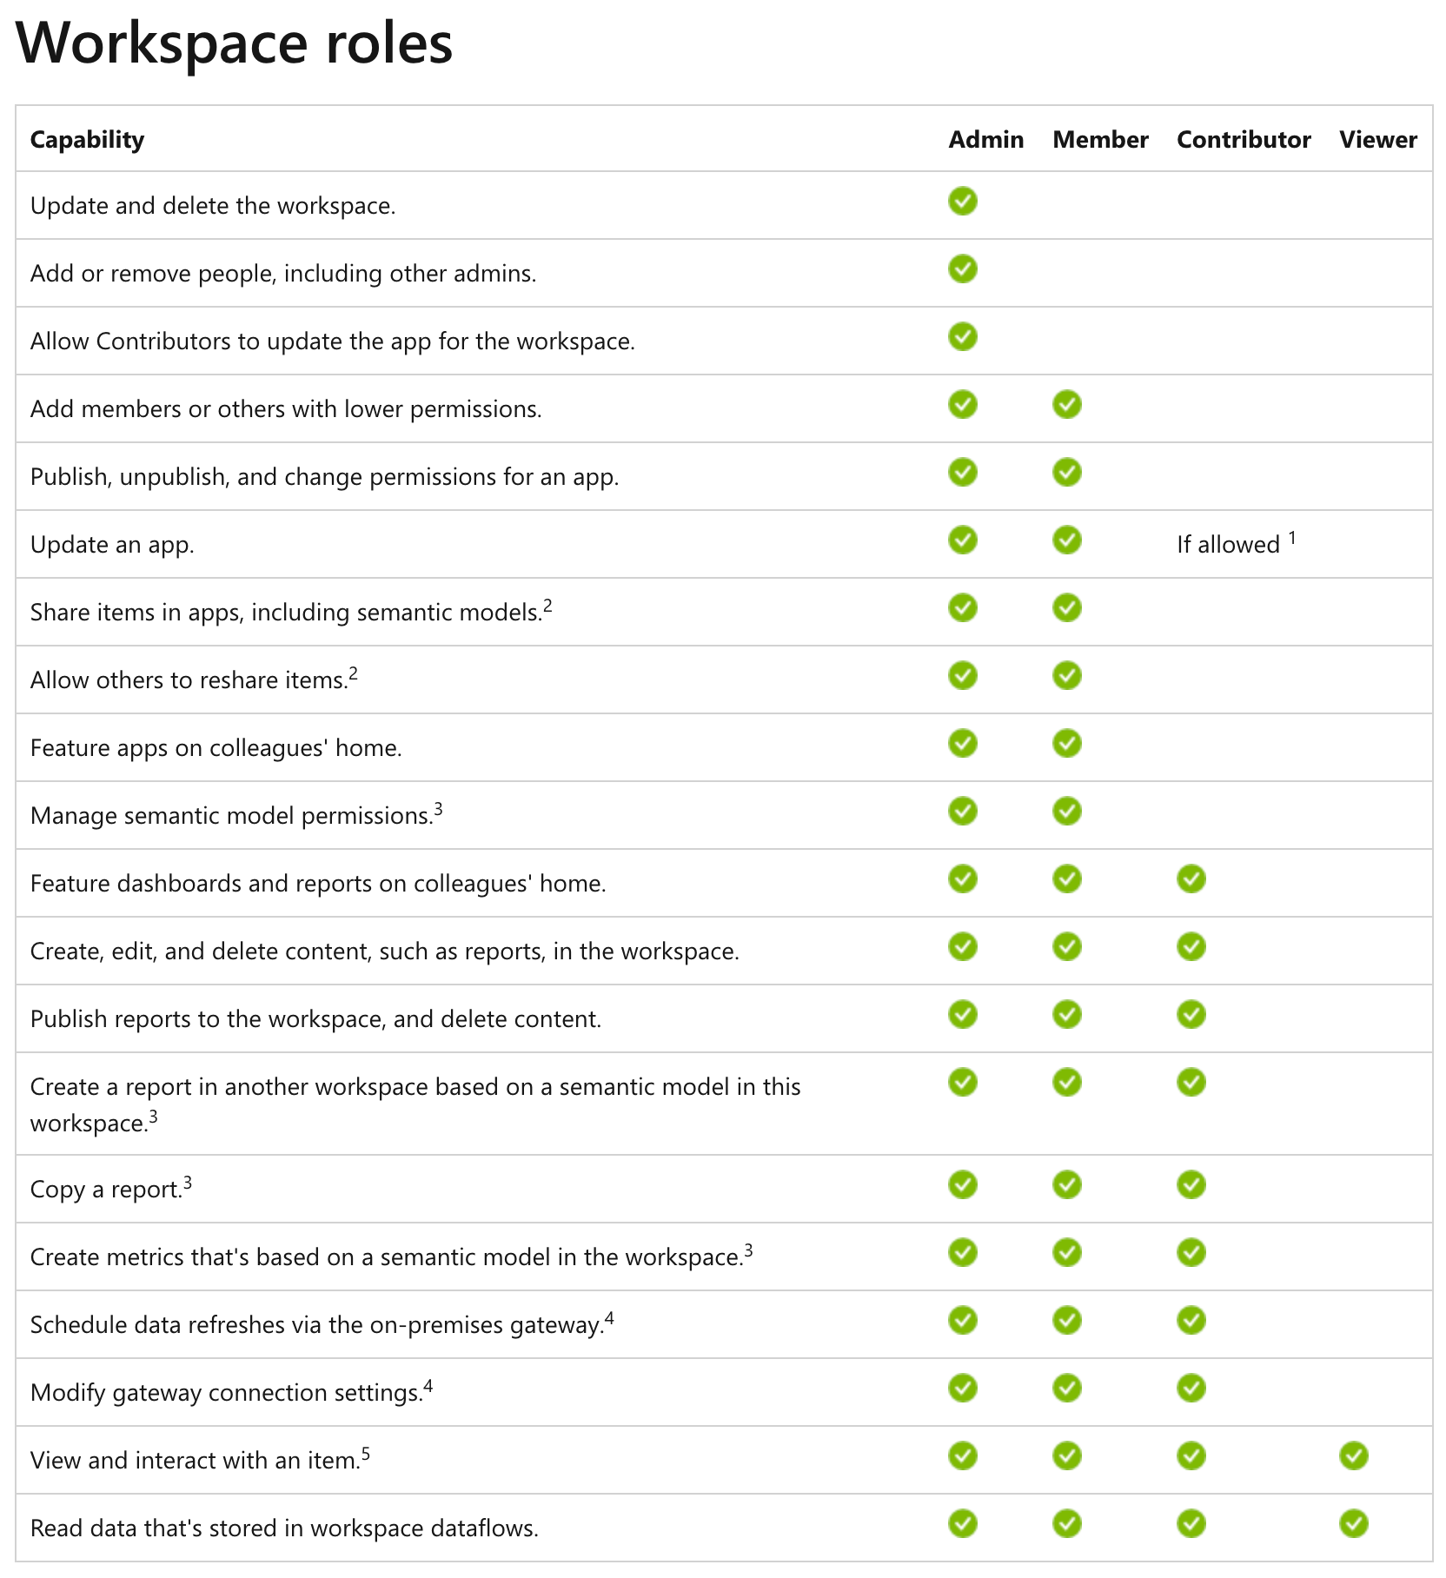

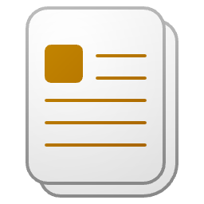




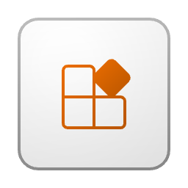


How we work today – our beloved workspace

Slide 7

Microsoft Fabric is entering the stage

Slide 8








Microsoft Fabric
Unified analytics platform
Lake centric and open
Empower every Office user
Pervasive security and governance
Data
Factory
Synapse Data
Engineering
Synapse Data Warehouse
Synapse Data Science
Synapse Real Time Analytics
Power BI
Data Activator (coming soon)
OneLake

Slide 9

The (awesomeness) of Fabric (probably I’m biased)
All the compute engines store their data automatically in OneLake
The data is stored in a single common format
Delta – Parquet, an open standards format, is the storage format for all tabular data in Analytics vNext
Once data is stored in the lake, it is directly accessible by all the engines without needing any import/export
All the compute engines have been fully optimized to work with Delta Parquet as their native format
Shared universal security model is enforced across all the engines
Synapse Data
Science
Synapse Data Warehousing
Data
Factory
Synapse Data
Engineering
Synapse Real Time Analytics
Power BI
Data Activator
Serverless
Compute
Spark
T-SQL
KQL
Analysis Services
OneLake
Customers 360
Finance
Service Telemetry
Business KPIs
Delta – Parquet Format
Delta – Parquet Format
Delta – Parquet Format
Delta – Parquet Format

Slide 10
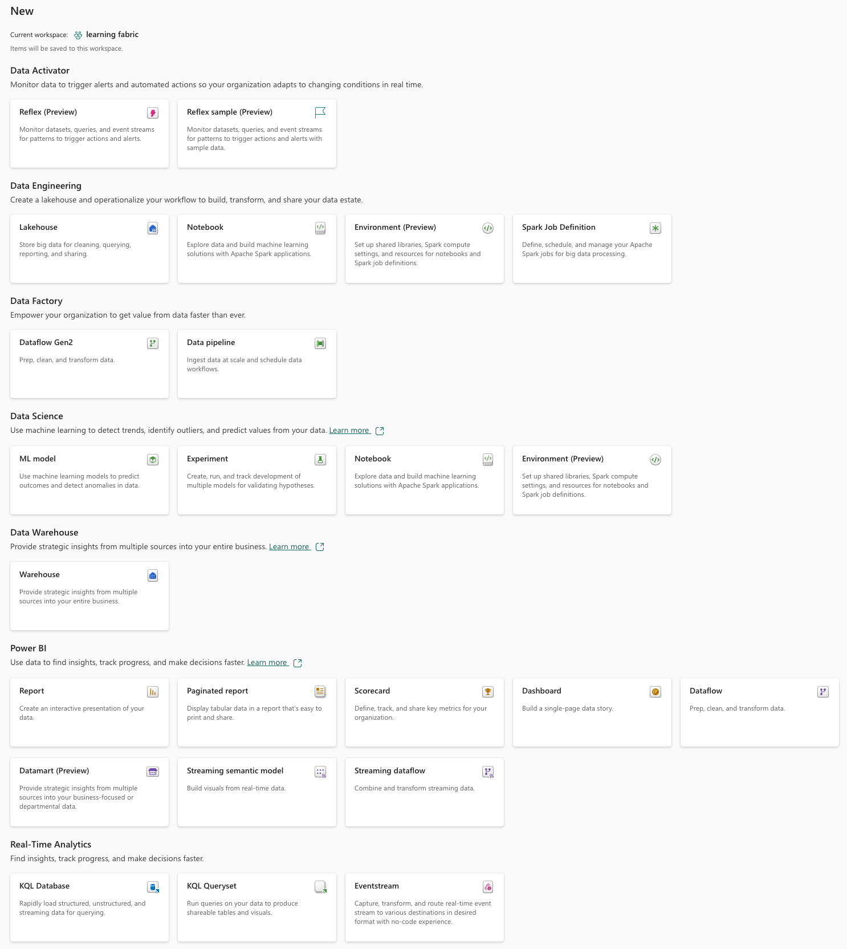
The Power BI “world” has transformed into a Microsoft Fabric cosmos (basically, this is good)
The amazing things we can create now and that will be stored inside a workspace (so much more than a simple container)!

Slide 11
The “simple” Power BI workspace roles (remember from some slides ago)
https://learn.microsoft.com/en-us/power-bi/collaborate-share/service-roles-new-workspaces

Slide 12
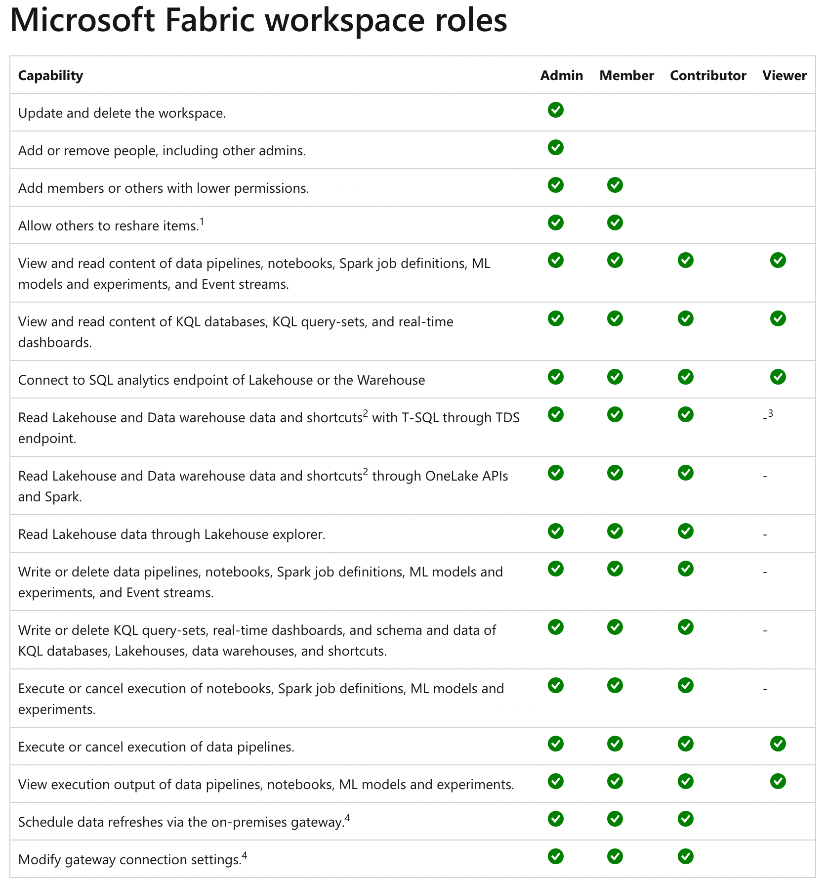
The “simple” Power BI workspace roles are not simple anymore
https://learn.microsoft.com/en-us/fabric/get-started/roles-workspaces

Slide 13

Now, how do we get our items safe

Slide 14

Some words about Azure Security
Authentication
MFA
Conditional Access
Authorization

Slide 15




Some words about Azure Security
Connecting to delta tables is simple, leveraging the Power of Fabric shortcuts, but maybe not easy ☺

Slide 16

Some words about Azure Security
Connecting to delta tables is simple, leveraging the Power of Fabric shortcuts, but maybe not easy ☺
Fabric needs access to the delta tables that may reside behind a firewall rule

Slide 17
Some words about Azure Security
Connecting to delta tables is simple, leveraging the Power of Fabric shortcuts, but maybe not easy ☺
Fabric needs access to the delta tables that may reside behind a firewall rule.
The Fabric workspace becomes an identity that can be registered with the storage account (https://learn.microsoft.com/en-gb/fabric/release-plan/admin-governance#fabric-azure-storage)

Slide 18
Some words about Azure Security
These are only two of the many security features that come with Azure

Slide 19

Now something different (risk mitigation by organizing our workloads)

Slide 20
The “simple” Power BI workspace roles are not simple anymore
https://learn.microsoft.com/en-us/fabric/get-started/roles-workspaces

Slide 21



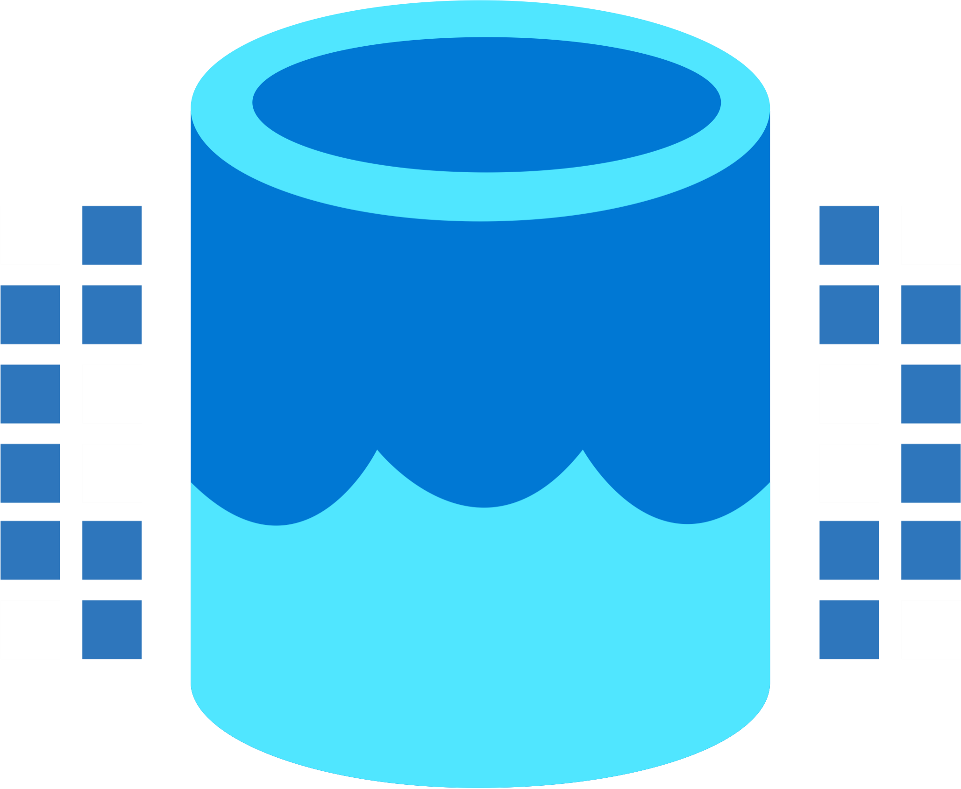


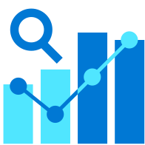

It’s not just the items we are able to create, the team is growing
Data Integration
Data Lake
Spark Engines
Data
Warehouse
Real Time Analytics
Data
Science
Business
Intelligence
Governance
Microsoft Fabric Unified analytics platform
End-to-end analytics data fabric
From the data lake to the business user

Slide 22
It’s not just the items we are able to create, the team is growing
Data Integration
Data Lake
Spark Engines
Data
Warehouse
Real Time Analytics
Data
Science
Business
Intelligence
Governance
Microsoft Fabric Unified analytics platform
End-to-end analytics data fabric
From the data lake to the business user

Slide 23
It’s not just the items we are able to create, the team is growing
Data Integration
Data Lake
Spark Engines
Data
Warehouse
Real Time Analytics
Data
Science
Business
Intelligence
Governance
Microsoft Fabric Unified analytics platform
End-to-end analytics data fabric
From the data lake to the business user

Slide 24
The “simple” Power BI workspace roles are not simple anymore (repeat)
https://learn.microsoft.com/en-us/fabric/get-started/roles-workspaces

Slide 25
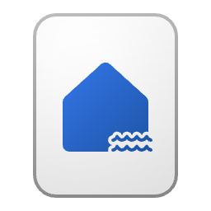
The landscape of a Microsoft Fabric solution! (My thinking)
The Lakehouse – Medallion architecture
Using dedicated workspaces helps to keep your items from different workloads and, for this reason safe from accidental harm, next to that, it and provides many more advantages, e.g. spreading workloads across capacities
Bronze (Landing Zone)
Silver
Gold (Business level aggregates)
Data
Science

Slide 26
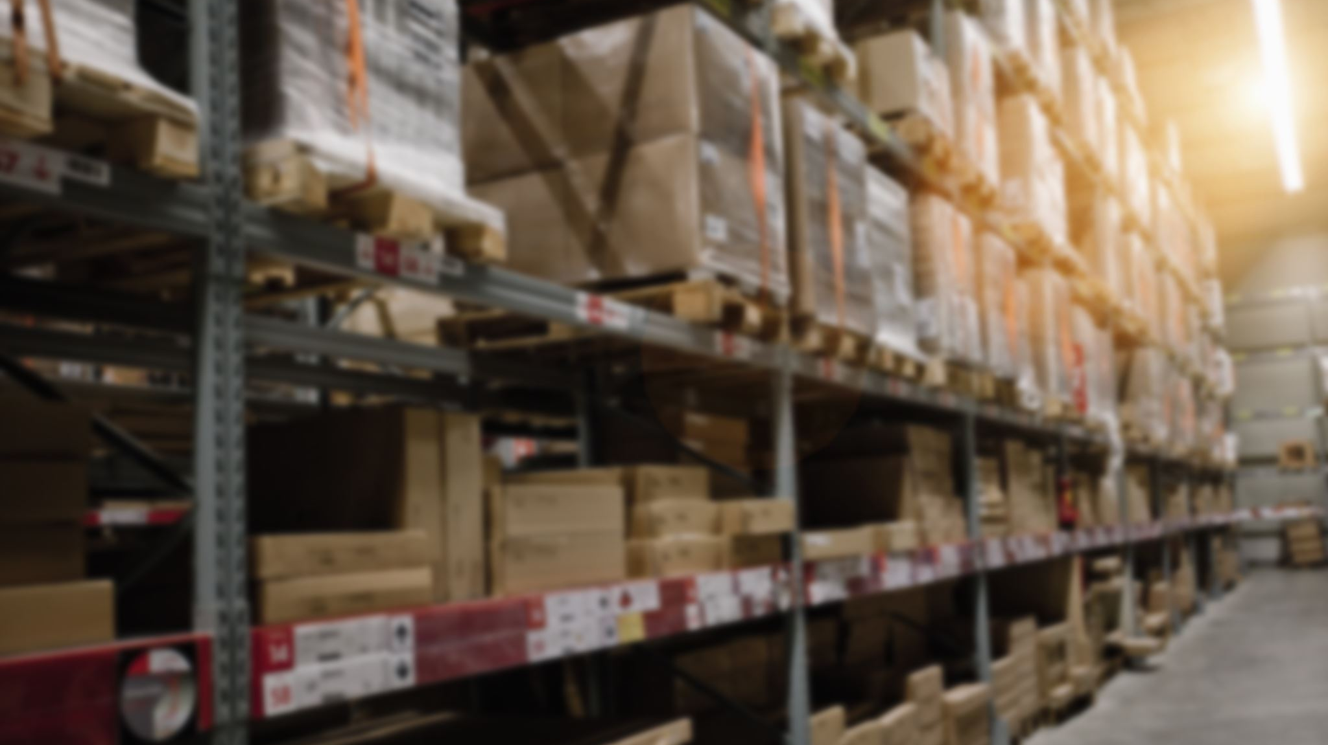
Use SQL security features with the data warehouse item

Slide 27
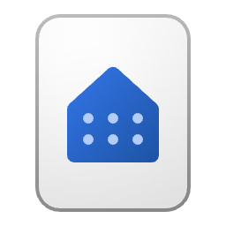

Rstrict Access to objects using T-SQL on the warehouse
The data owning workspace
Use SQL commands in the data owning workspace to restrict access like
DENY SELECT ON OBJECT::dbo.DimDate TO [mvp@minceddata.com];
The data modeling workspace
Business
Intelligence
Synapse Data Engineering

Slide 28
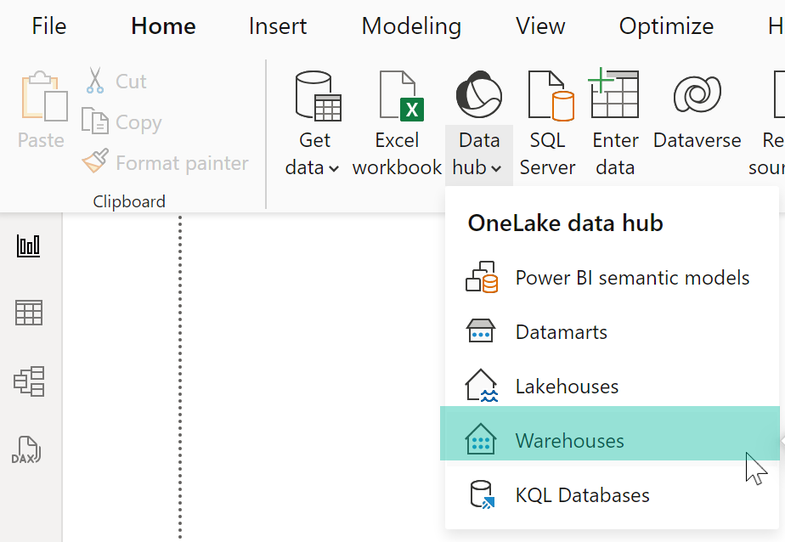
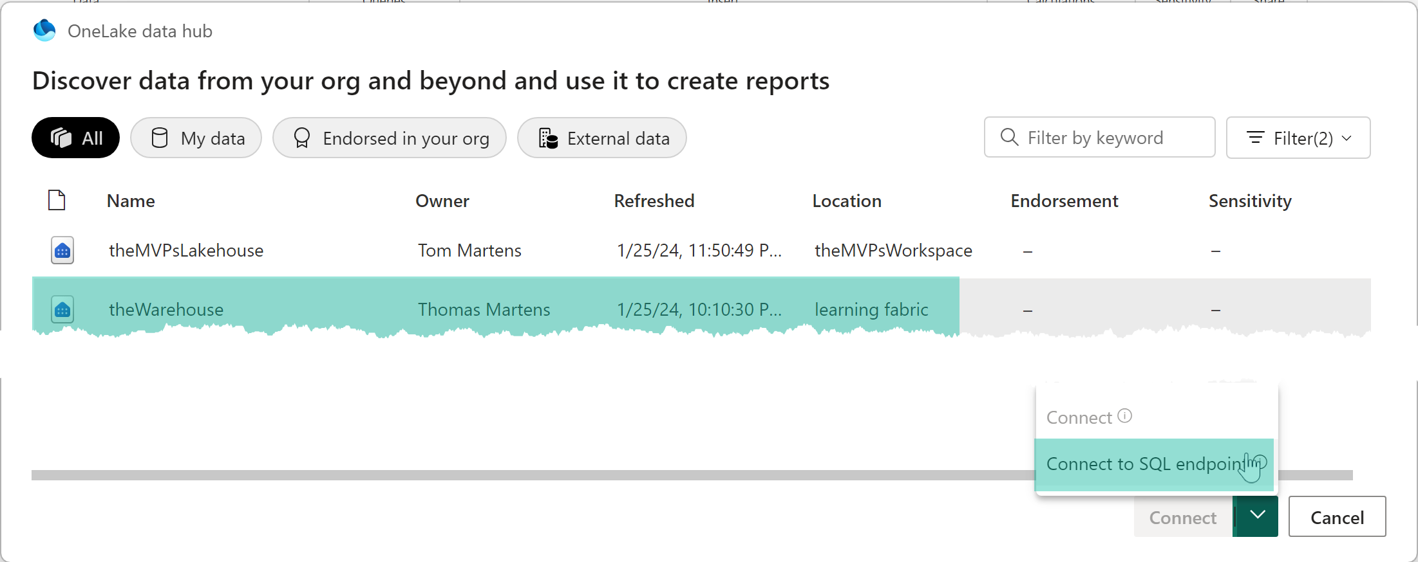
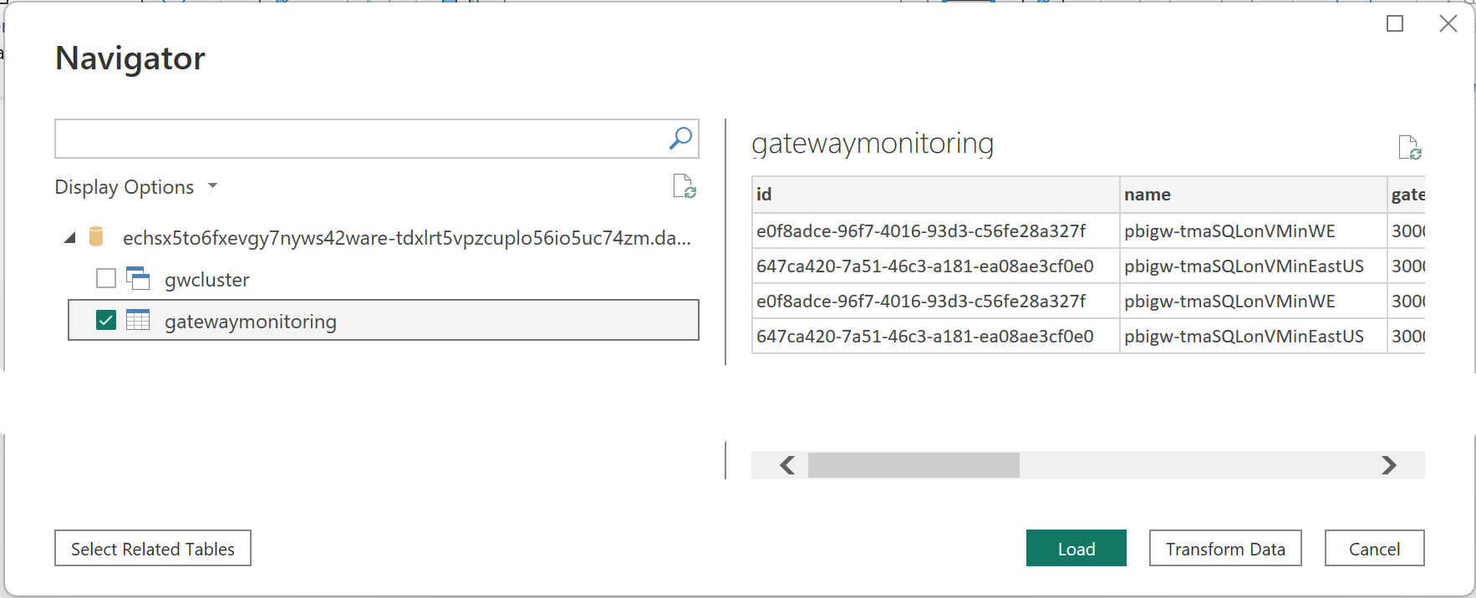
Rstrict Access to objects using T-SQL on the warehouse (connecting from Power BI)

Slide 29

OneSecurity will change a lot (another game changer)
https://learn.microsoft.com/en-gb/fabric/release-plan/onelake#onesecurity

Slide 30

And now, what?
Get ready for new capabilities!
Understanding core concepts of Microsoft Fabric, like
OneLake, Shortcuts, and the separation of storage and computing are a must, but Azure is not just data!
Do not forget your security requirements 😉

Slide 31
Thank you

